Slide 1
Sumblr: Continuous Summarization of Evolving Tweet Streams
Date： 2014/08/11
Author ： Lidan Shou, Zhenhua Wang, Ke Chen, Gang Chen
Source： SIGIR’13
Advisor: Jia-ling Koh
Speaker： Sz-Han,Wang

Slide 2
Outline
Introduction
Method
Tweet Stream Clustering
High-level Summarization
Experiment
Conclusion

Slide 3
Introduction
With the explosive growth of microblogging services, short text messages (also known as tweets) are being created and shared at an unprecedented rate.
Tweets in its raw form can be incredibly informative, but also overwhelming.
Plowing through so many tweets for interesting contents would be a nightmare, not to mention the enormous noises and redundancies that one could encounter.

Slide 4
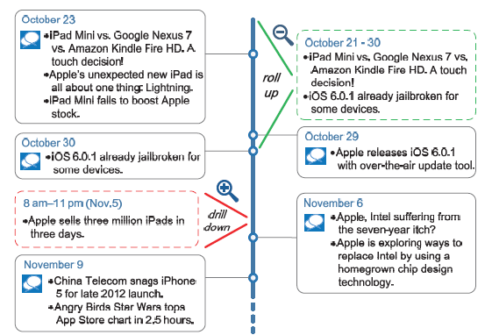
Introduction
In this paper, we study continuous tweet summarization as a solution.
Traditional document summarization methods focus on static and small-scale data.
Propose a novel prototype called Sumblr ( SUMmarization By stream cLusteRing) for tweet streams.
A timeline example for topic “Apple”

Slide 5
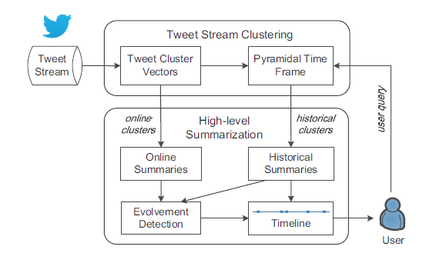
Framework

Slide 6
Outline
Introduction
Method
Tweet Stream Clustering
High-level Summarization
Experiment
Conclusion

Slide 7
Tweet Cluster Vector
a tweet t_{i} =(tv_{i}, ts_{i},w_{i})
Alice: a b c b e a e b.
tv_{i}=$[ ]$
For a cluster C containing tweets t₁, t₂,… t_{n}
Tweet Cluster Vector(TCV)(c)=(sum_v,wsum_v,ts1,ts2,ft_set)
sum_v=$\sum_{i=1}^{n}{\frac{\text{tv}\text{i}}{||\text{tv}\text{i}||}}$ , wsum_v=$\sum_{i=1}^{n}{\text{w}\text{i}∙\text{tv}\text{i}}$
The vector of cluster centroid(cv)=$\frac{\sum_{i=1}^{n}{\text{w}\text{i}∙\text{tv}\text{i}}}{n}=\frac{wsum_v}{n}$
a | b | c | e
1.301 | 1.477 | 1 | 1.301
TF-IDF score
Notes:
tv_{i}:the textual vector,ts_{i}:the posted timestamp
w_{i} : the UserRank value of the tweet’s author
ts1=$\sum_{i=1}^{n}{\text{ts}\text{i}}$ is the sum of timestamps
ts2=$\sum_{i=1}^{n}{\text{(}\text{ts}\text{i}\text{)}\text{2} }$ is the quadratic sum of timestamps
ft_set is a focus tweet set of size m, consisting of the closest m tweets to the cluster centroid (use cosine similarity as the distance metric)

Slide 8
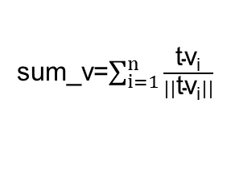
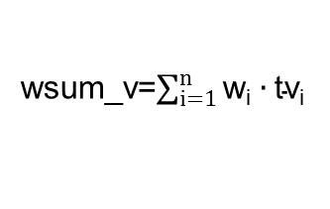
Tweet Cluster Vector
 | a | b | c | d | e | |tvi|
t1 | 1.301 | 1.477 | 1 | 0 | 1.301 | 2.563
t2 | 1 | 1 | 1.301 | 1.301 | 1 | 2.527
t3 | 1.477 | 1 | 1 | 1 | 1 | 2.486
t4 | 0 | 1.602 | 0 | 1 | 1.301 | 2.293
t5 | 0 | 1.477 | 1.477 | 0 | 0 | 2.089
t1-Alice: a b c b e a e b.
t2-Tim : a c c d d b e.
t3-Judy: b c d e a a a.
t4-Tina : b b d e e b b.
t5-Sam : c c c b b b .
sum_v=$\sum_{i=1}^{n}{\frac{\text{tv}\text{i}}{||\text{tv}\text{i}||}}$
 | sim(cv,ti)
t1 | 0.934
t2 | 0.951
t3 | 0.943
t4 | 0.815
t5 | 0.757
 | a | b | c | d | e
sum_v | 1.497 | 2.780 | 2.014 | 1.353 | 1.873
Suppose m=3:
ft_set = {t2, t1, t3}
wsum_v=$\sum_{i=1}^{n}{\text{w}\text{i}∙\text{tv}\text{i}}$
 | a | b | c | d | e
wsum_v | 3.778 | 6.556 | 4.778 | 3.301 | 4.602
$$sim(cv,ti)$$
$$cv=\frac{wsum_v}{n}$$
 | a | b | c | d | e
cv | 0.756 | 1.311 | 0.956 | 0.660 | 0.920

Slide 9
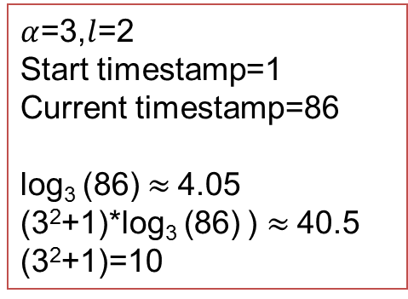
Pryamidal Time Frame
The Pyramidal Time Frame (PTF) stores snapshots at differing levels of granularity depending on the recency.
The maximum order of any snapshot stored at T is log$α$(T);
The maximum number of snapshots maintained at T is ($αl$+1) ‧ log$α$(T)
Each snapshot of the i-th order is taken at a moment in time when the timestamp from the beginning of the stream is exactly divisible by α^{i}
Each i-th order stored the maximum number of snapshots is ($αl$+1)
$α$=3,$l$=2
Start timestamp=1
Current timestamp=86
log₃ (86) $≈$4.05
(3²+1)*log₃ (86) ) $≈$40.5
(3²+1)=10

Slide 10
Tweet Stream Clustering
Intialization
Use a k-means clustering algorithm to create the initial clusters
Incremental Clustering
t1, t2, t3, t4, t5
MBS(Minimum Bounding Similarity)=$β∙\overline{Sim\left(c1, ti\right)}$
$\overline{Sim\left(c1, ti\right)}$=$\frac{1}{n}\sum_{i=1}^{n}{\frac{\text{tv}\text{i}∙C1}{||\text{tv}\text{i}||∙||C1||}}=\frac{\text{wsum}\text{_}\text{v}∙\text{sum}\text{_}\text{v}}{n∙||\text{wsum}\text{_}\text{v}||}$
TVC(1)
c1
Max
Sim(c1,t)
t6, t7, t8
MaxSim(c1, t) < MBS
→ t is upgraded to a new cluster
MaxSim(c1, t) ≥ MBS
→ t is added to its closest cluster
c2
Sim(c2,t)
t
TVC(2)
t9, t10
Sim(c3,t)
TVC(3)
c3

Slide 11
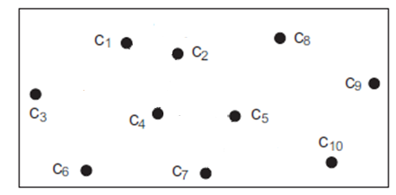
Tweet Stream Clustering
Restrict the number of active clusters
Deleting Outdated Clusters - periodical examination
Avg_{p} > threshold → remove the cluster
Merging Clusters - memory limit is reached
Merging process continues until there are only mc percentage of the original clusters left
threshold=3 days, p=10
Suppose mc=0.7, Remove:10*(1-0.7)=3 cluster
Before Merging:c1,c2,c3,c4,c5,c6,c7,c8,c9,c10
cluster pairs distance
(c1,c2)
(c2,c4)
(c1,c4)
(c5,c7)
(c4,c5)
……
{c1,c2}
{c1,c2,c4}
{c5,c7}
After Merging:{c1,c2,c4},c3,{c5,c7},c6,c8,c9,c10

Slide 12
High-level Summarization
Online summaries
Retrieved directly from the current clusters maintained in the memory
Historical summaries
Retrieved two snapshots from PTF
TCV-Rank Summarization

Slide 13
TCV-Rank Summarization
Generate input cluster
Gather tweets from the ft_sets in D(c) as a set T
S(ts1)
S(ts2)
TCV(C1)
TCV(C2)
TCV(C4)
TCV(C5)
ft_set:{t1,t2,t3}
ft_set:{t4,t5}
ft_set:{t1,t2,t8}
ft_set:{t9,t10}
TCV(C1-C4)
TCV(C3)
TCV(C6)
ft_set:{t6,t7}
ft_set:{t3}
ft_set:{t11}
the ending timestamp of the duration
the beginning timestamp of the duration
input cluster D(c)
TCV(C1-C4)
TCV(C2)
TCV(C3)
ft_set:{t3}
ft_set:{t4,t5}
ft_set:{t6,t7}
T={t1,t2,t3,t4,t5,t6,
t7,t8,t9,t10,t11}
TCV(C4)
TCV(C5)
TCV(C6)
ft_set:{t1,t2,t8}
ft_set:{t9,t10}
ft_set:{t11}

Slide 14
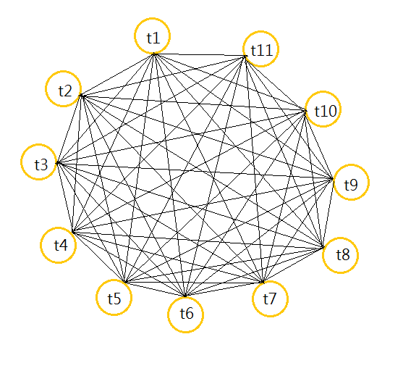
TCV-Rank Summarization
Build a cosine similarity graph on T
Compute LexRank scores LR
Add tweet t into the summary
$t=$ $\underset{ti}{argmax}$[$λ\frac{nti}{nmax}LR\left(ti\right)−\left(1−λ\right)\underset{tj∈S}{avg}Sim\left(ti,tj\right)$]
T={t1,t2,t3,t4,t5,t6,t7,t8,t9,t10,t11}
tvi | t1 | t2 | t3 | t4 | t5 | t6 | t7 | t8 | t9 | t10 | t11
LR | 0.601 | 0.847 | 0.349 | 0.752 | 0.591 | 0.799 | 0.355 | 1 | 0.592 | 0.691 | 0.592

Slide 15
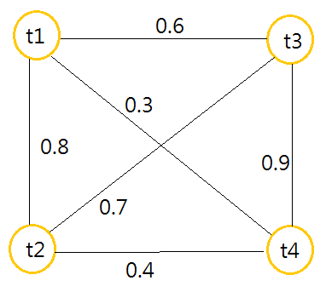
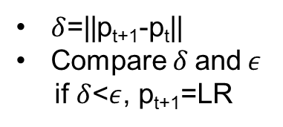
LexRank
Build cosine similarity Matrix and degree
LR=PowerMethod(M,n,$ε$)
Matrix M
 | t1 | t2 | t3 | t4
t1 | 1 | 0.8 | 0.6 | 0.3
t2 | 0.8 | 1 | 0.7 | 0.4
t3 | 0.6 | 0.7 | 1 | 0.9
t4 | 0.3 | 0.4 | 0.9 | 1
i | degree
t1 | 3
t2 | 3
t3 | 4
t4 | 2
 | t1 | t2 | t3 | t4
t1 | 0.33 | 0.27 | 0.15 | 0.15
t2 | 0.27 | 0.33 | 0.18 | 0.2
t3 | 0.2 | 0.23 | 0.25 | 0.45
t4 | 0.1 | 0.13 | 0.23 | 0.5
Sim[i][j] > t
(t=0.5)
$$\frac{sim\left[i\right][j]}{degree[i]}$$
p_{t}
0.25
0.25
0.25
0.25
p_{t+1}
0.23
0.24
0.20
0.33
$δ$=||p_{t+1}-p_{t}||
Compare$δ$and $ε$
if $δ$<$ε$, p_{t+1}=LR
p_{t+1}=M^{T}p_{t}

Slide 16
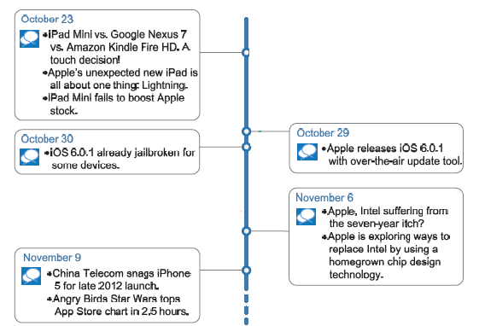
Topic Evolvement Detection
Continuous timeline
Compute D_{cur} and D_{avg}
if $\frac{\text{D}\text{cur}}{\text{D}\text{avg}}$ > $τ$ , add time node
S_{p}
Kullback–Leibler divergenc
D_{KL}(S_{c}||S_{p})
=$\sum_{w∈V}{p(w|Sc)\ln{\frac{p(w|sc)}{p(w|sp)}}}$
Current summary
Add to timeline
S_{c}
current summary
The iPhone 6 release date will be in 2014

Slide 17
Outline
Introduction
Method
Tweet Stream Clustering
High-level Summarization
Experiment
Conclusion

Slide 18
Experiment
Datasets
Baseline
ClusterSum
LexRank
DSDR

Slide 19
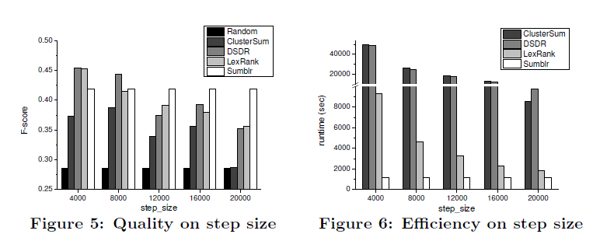
Experiment
windows size=20000
step size=4000~20000

Slide 20
Outline
Introduction
Method
Tweet Stream Clustering
High-level Summarization
Experiment
Conclusion

Slide 21
Conclusion
Proposed a prototype called Sumblr which supported continuous tweet stream summarization.
Sumblr employed a tweet stream clustering algorithm to compress tweets into TCVs and maintain them in an online fashion.
Used a TCV-Rank summarization algorithm for generating online summaries and historical summaries with arbitrary time durations.
The topic evolvement could be detected automatically, allowing Sumblr to produce dynamic timelines for tweet streams.
For future work, we aim to develop a multi-topic version of Sumblr in a distributed system, and evaluate it on more complete and large-scale datasets.

